Slide 1


Sugar code: crafting a healthy tomorrow using Machine learning
26th April 2024

Slide 2

Problem Statement
Diabetes is a chronic health condition that affects millions of individuals in the United States, leading to severe complications and a significant economic burden.
How can Machine learning help here?
By leveraging machine learning models to predict diabetes using various factors affecting the disease, we can develop a powerful predictive tool that can aid in early detection, targeted interventions, and resource allocation.

Slide 3
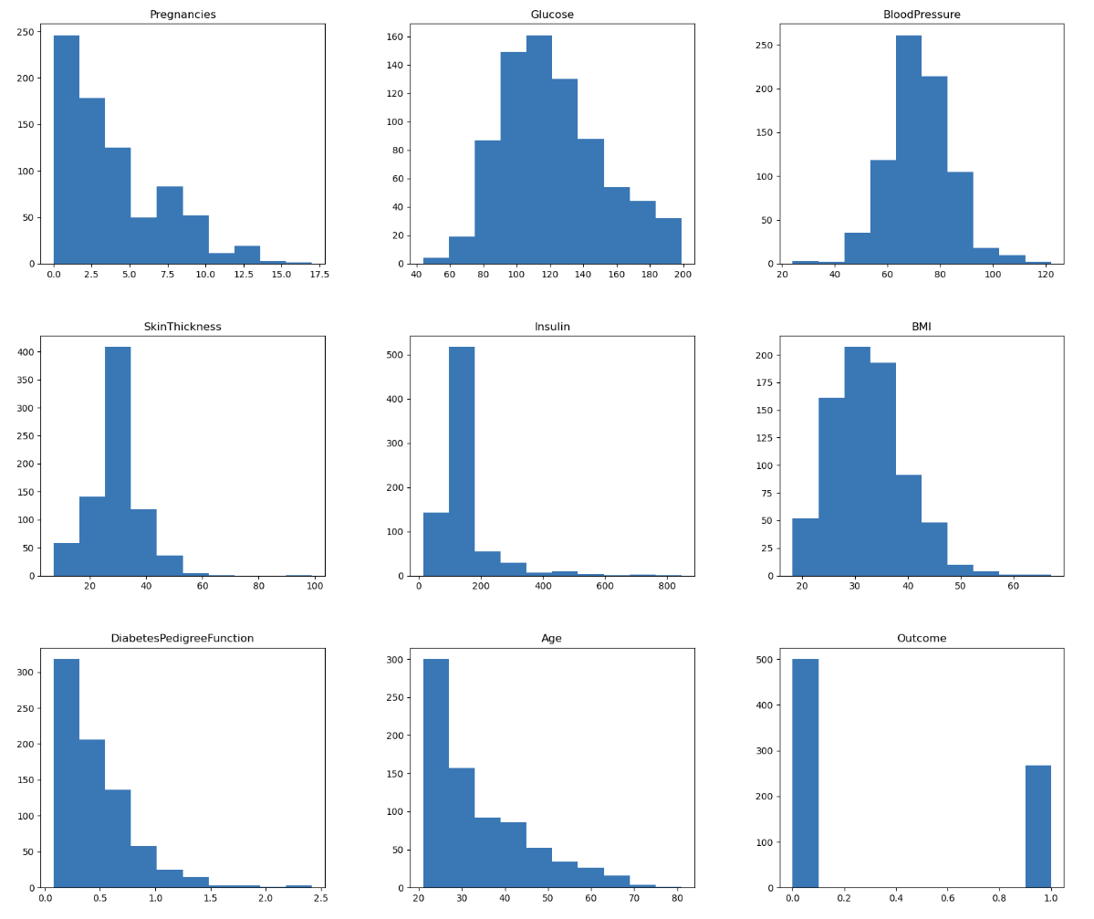
Exploratory Data Analysis (EDA)
Pregnancies
Glucose
Blood Pressure
Skin Thickness
Insulin
BMI
Diabetes Pedigree Fn.
Age
Outcome (Target)

Slide 4
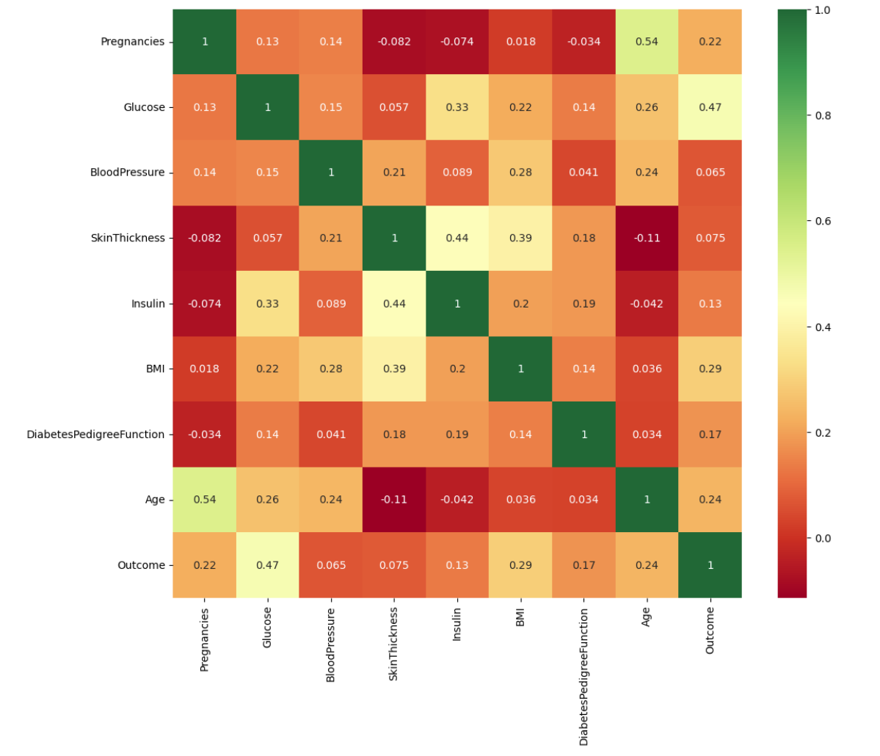
Descriptive Analysis: Correlation Plot

Slide 5
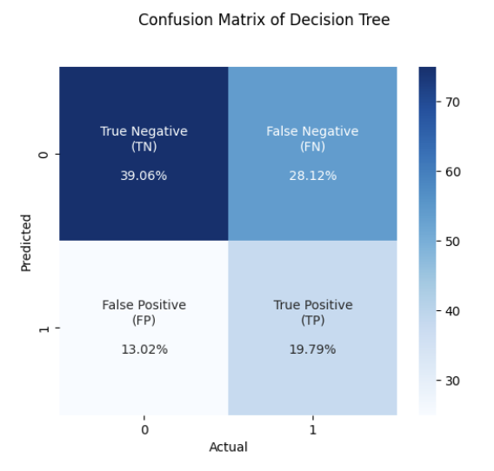
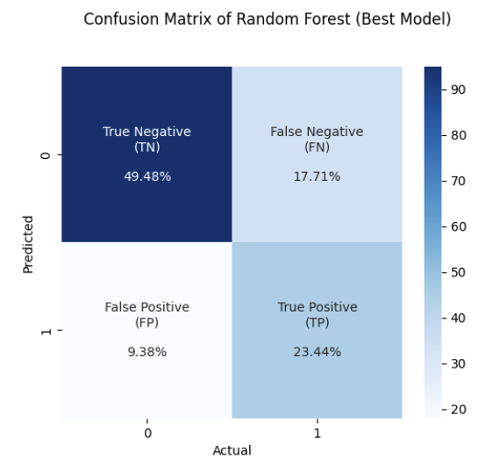
Which Model explains better?

Slide 6
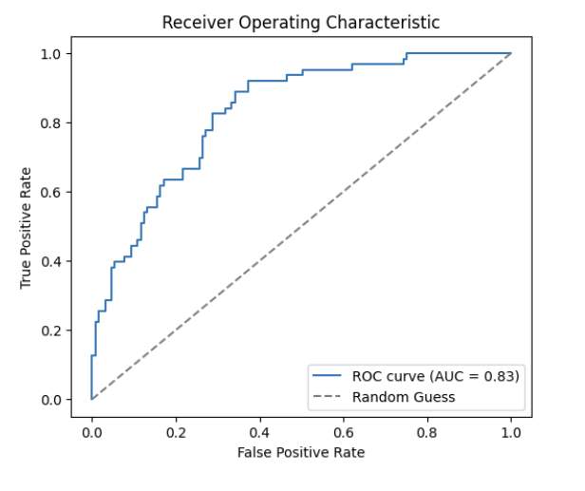
How accurate is our model?

Slide 7
Important features causing Diabetes

Slide 8
Suggestions for a healthier living!
Glucose levels should be maintained –
Men should consume no more than 9 teaspoons (36 grams or 150 calories) of added sugar per day.
For women, the number is lower: 6 teaspoons (25 grams or 100 calories) per day.
Some of us may have a genetic predisposition to diabetes. While you can't change your genetics, you can manage your risk through healthy lifestyle choices. Aim to workout for at least 150 minutes/week to keep your BMI under control.
Diabetes Pedigree Function estimates the likelihood of diabetes based on family history. A higher value indicates a higher risk, so it makes sense that this is an important feature.
Source: American Heart Association

Slide 9
Thank you
Guide: Prof. Yue Gao
Team: Gobind Uttamkumar
Trishali Yogesh Rao

